Slide 1


Key Findings
The Right Choices to Cut Poverty and Restore Shared Prosperity: Half in Ten Report 2012
Erik R. Stegman, Manager, Half in Ten

Slide 2
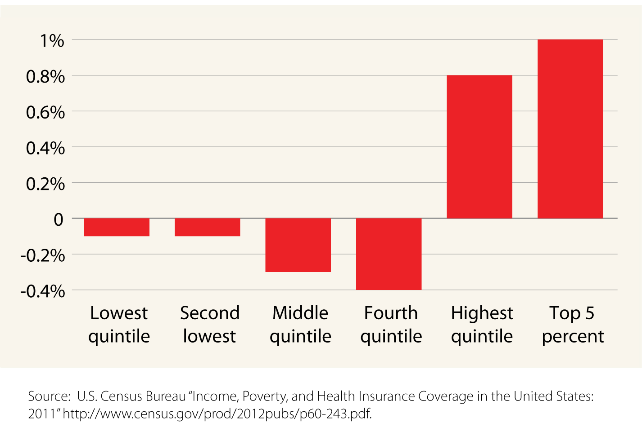

The economy grew…but so did income inequality
Top 20% see income gains in 2011 while incomes fall or stagnate for low- and middle-income families

Slide 3
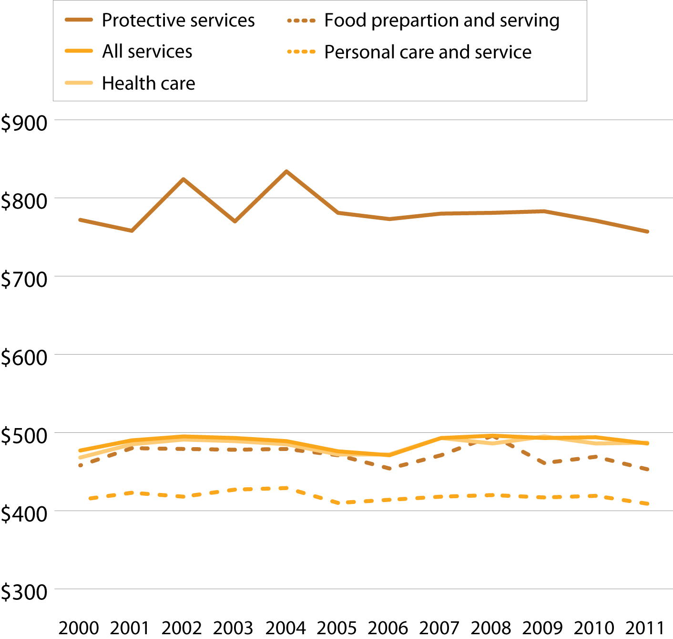

Stagnant service incomes
Real median weekly earnings for workers in service occupations over the last decade

Slide 4
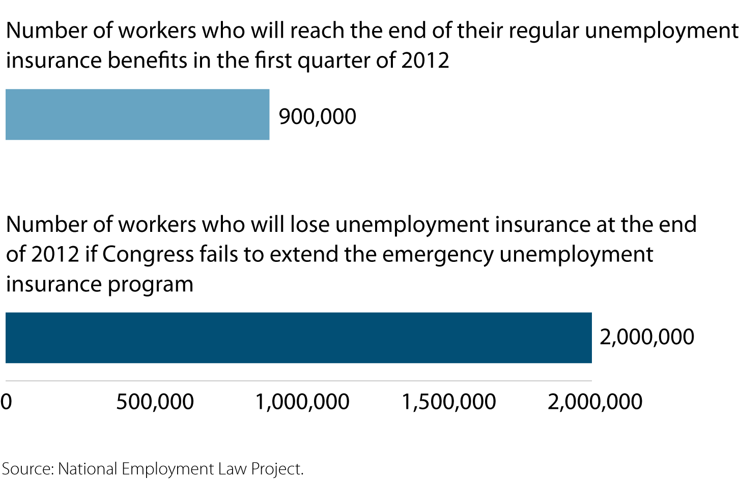

Unemployment insurance critical to our recovery
3 million unemployed workers could lose unemployment insurance in the next few months if Congress doesn’t act

Slide 5
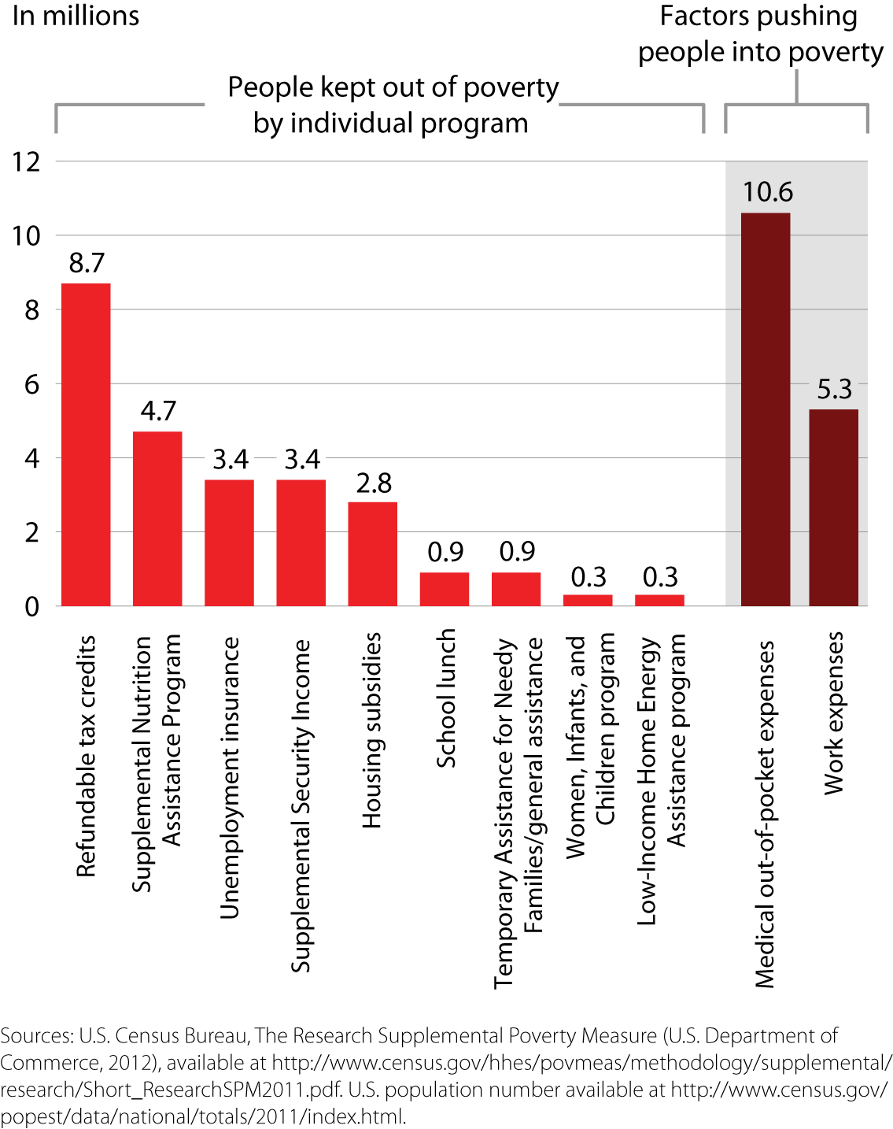

Tax credits & nutrition assistance kept families out of poverty
The Supplemental Poverty Measure shows that refundable
tax credits such as the earned income and child tax credits kept 8.7 million people out
of poverty in 2011, and that the Supplemental Nutrition Assistance Program lifted 4.7 million
people above the poverty line.

Slide 6
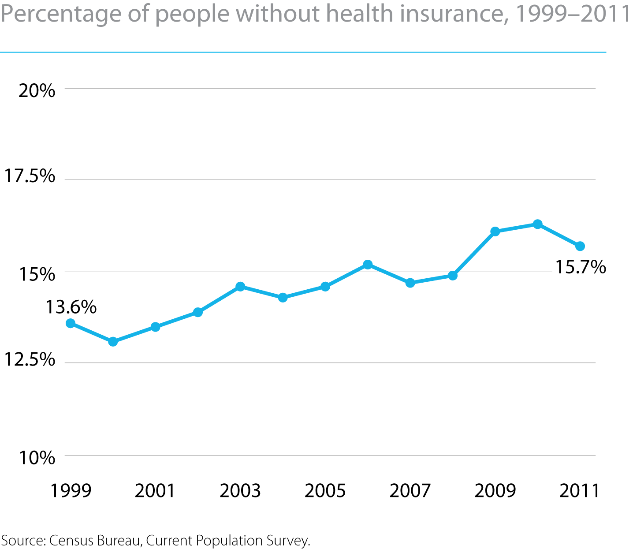

Health insurance coverage on the rise: early effects of the ACA
The number of Americans without health insurance rose steadily until 2011. Due to the early effects of the Affordable Care Act, a new positive trend in coverage is emerging.

Slide 7
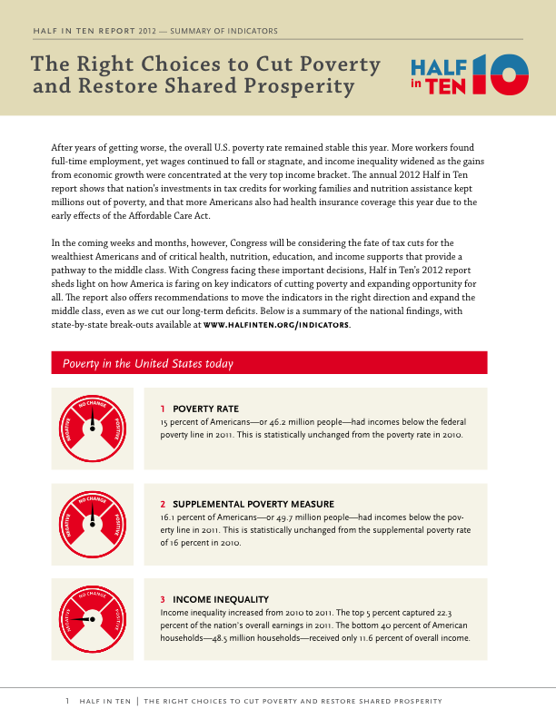
New tools and resources in this year’s report
At-a-glance fact sheets for each of our 21 indicators
Updated state-by-state data and rankings
Summary of findings fact sheet
Poverty and Opportunity Profile on the Latino Community: the First in Our New Half in Ten Demographic Series

